Slide 2
Objectives
Explain while loop
Explain for loop
Explain do..while loop
Explain break and continue statement
Explain single-dimensional arrays
Explain multi-dimensional arrays
Explain for..in loop

Slide 3
Introduction
Loops allow you to execute a single statement or a block of statements multiple times.
They are widely used when you want to display a series of numbers and accept repetitive input.
A loop construct consists of a condition that instructs the compiler the number of times a specific block of code will be executed.
If the condition is not specified within the construct, the loop continues infinitely. Such loop constructs are referred to as infinite loops.
JavaScript supports three types of loops that are as follows:
while Loop
for Loop
do-while Loop

Slide 4
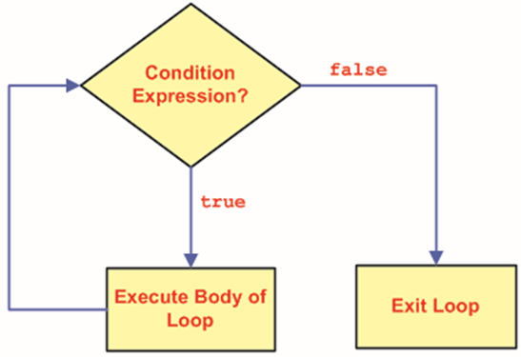
while Loop
Syntax:
while (condition) {
// statements;
}
where,
condition: Is a boolean expression.
Code Snippet displays the sum of numbers from 1 to 10 by using the while loop.
<script>
var i =0, sum= 0;
while (i <=10)
{
sum += i;
i++;
alert(“sum of first ten numbers:”+sum);
}
</script>

Slide 5
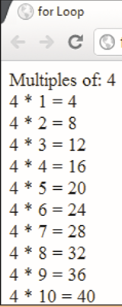
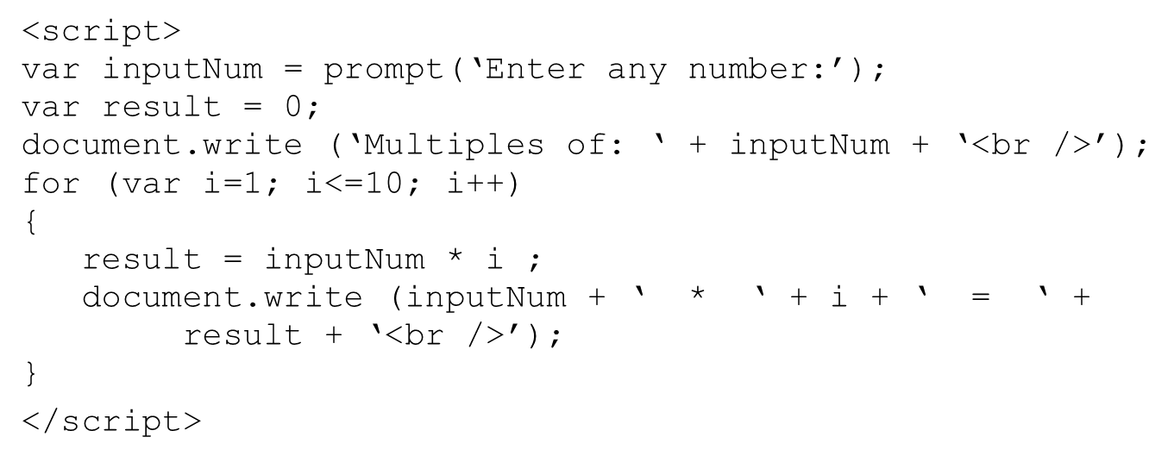
for Loop
Syntax:
for (initialization; condition; increment/decrement)
{
// statements;
}

Slide 6
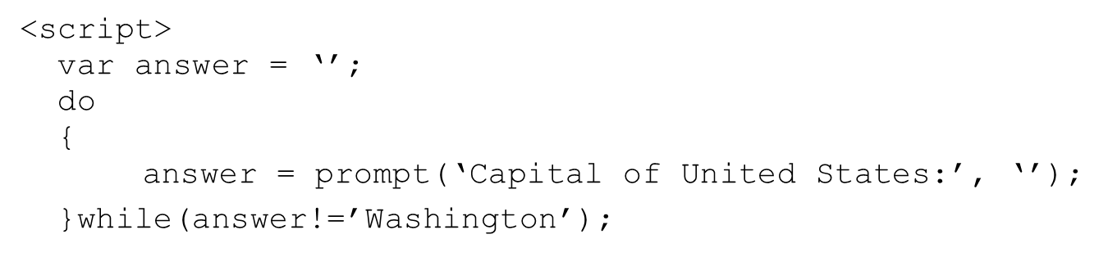
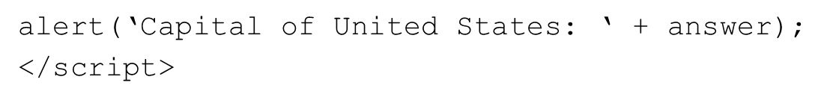
do-while Loop
Syntax:
do {
...
statements;
...
}while(condition);
where,
condition: Is a boolean expression.

Slide 7
break Statement
can be used with decision-making such as switch-case and loop constructs such as for and while loops.
The control is then passed to the next statement immediately after the loop.
It is used to exit the loop without evaluating the specified condition.

Slide 8
continue Statement 1-2
not terminate the loop entirely, but terminates the current execution.
terminate the current execution of the loop and continue with the next repetition by returning the control to the beginning of the loop.

Slide 9
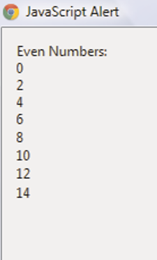
continue Statement 2-2
The Code Snippet displays even numbers from 0 to 15.
<script>
var result = ‘’;
for (var i = 0; i <= 15; i++)
{
if((i%2) != 0)
{
continue;
}
result = result + i + ‘\n’;
}
alert(‘Even Numbers:\n’ + result);
</script>

Slide 10
Arrays
is a collection of values stored in adjacent memory locations.
The values of an array variable must be of the same data type.
These values that are also referred to as elements can be accessed by using subscript or index numbers.
JavaScript supports two types of arrays that are as follows:
Single-dimensional array
Multi-dimensional array
The array variable can be created using the Array object and new keyword along with the size of the array element.

Slide 11
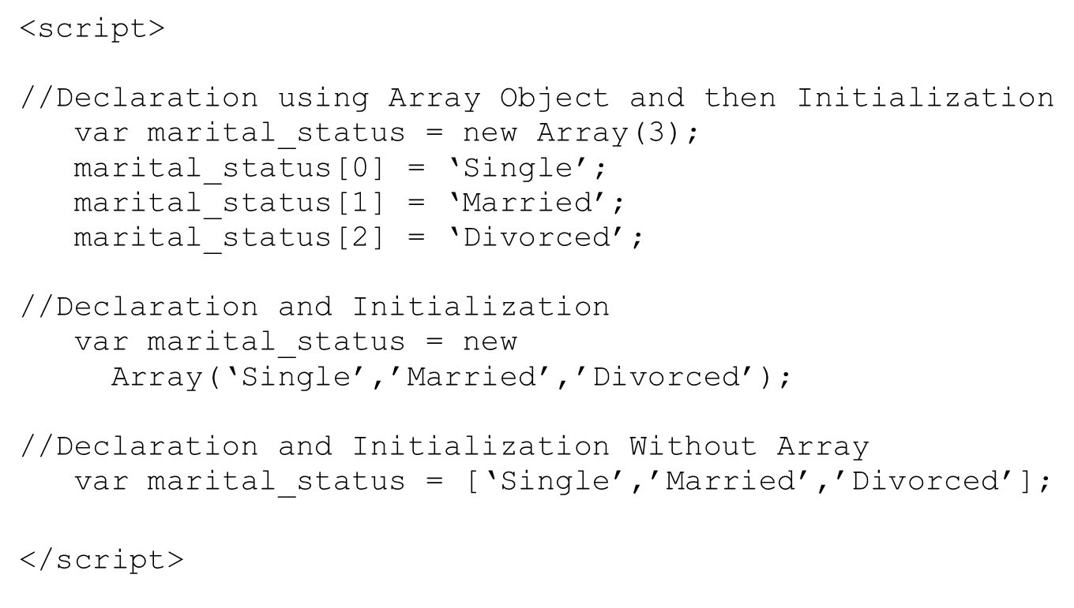
Single-dimensional Array
^{Syntax:}
var variable_name = new Array(size); //Declaration
variable_name[index] = ‘value’;

Slide 12
Accessing Single-dimensional Arrays
Accessing Array Elements Without Loops
An array element can be accessed by specifying the array name followed by the square brackets containing the index number.
The Code Snippet:
<script>
var names = new Array(“John”, “David”, “Kevin”);
alert(‘List of Student Names:\n’ + names[0] + ‘, ‘ + names[1] + ‘, ‘ + names[2]);
</script>

Slide 13
Accessing Single-dimensional Arrays
Accessing Array Elements With Loops
The Code Snippet demonstrates the script that creates an array to accept the marks of five subjects and display the average.
<script>
var sum = 0;
var marks = new Array(5);
for(var i=0; i<marks.length; i++)
{
marks[i] = parseInt(prompt(‘Enter Marks:’, ‘’));
sum = sum + marks[i];
}
alert(‘Average of Marks: ‘ + (sum/marks.length));
</script>

Slide 14
Multi-dimensional Array 1-2
A multi-dimensional array stores a combination of values of a single type in two or more dimensions.
A two-dimensional array is an array of arrays.
This means, for a two-dimensional array, first a main array is declared and then, an array is created for each element of the main array.

Slide 15
Multi-dimensional Array 2-2
The syntax to declare a two-dimensional array is as follows:
var var_name = new Array(size); //Declaration
var_name[index] = new Array(‘value1’,’value2’..);
where,
value1: Is the value at the first column.
value2: Is the value at the second column.
Following figure shows the declaration of a two-dimensional array.

Slide 16
Array Methods 1-2
In Javascript, array is an object. It has the length property that determine the number of elements in an array.
The various methods of the Array object allow to access and manipulate the array elements.
^{Method} | ^{Description}
concat() | Combines one or more array variables.
join() | Joins all the array elements into a string.
pop() | Retrieves the last element of an array.
push() | Appends one or more elements to the end of an array.
sort() | Sorts the array elements in an alphabetical order.

Slide 17
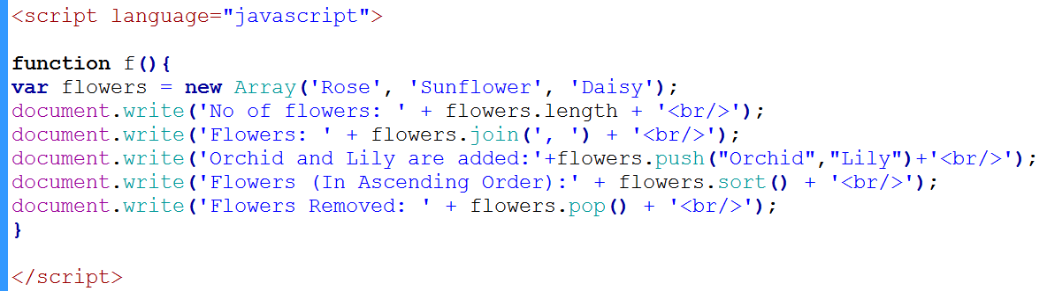
Array Methods 2-2
^{Example}
^{Output}

Slide 18
for..in Loop 1-3
is an extension of the for loop.
It enables to perform specific actions on the arrays of objects.
The loop reads every element in the specified array and executes a block of code only once for each element in the array.
^{Syntax:}
for (var_name in array_name)
{
//statements;
}
^{where,}
variable_name: Is the name of the variable.
^{array_name: Is the array name.}

Slide 19
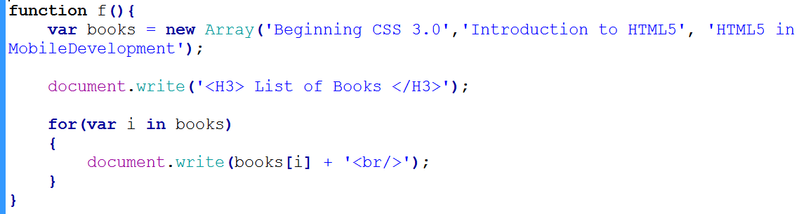
for..in Loop 2-2
^{Example}
^{Output}

Slide 20
Summary
A loop construct consists of a condition that instructs the compiler the number of times a specific block of code will be executed.
JavaScript supports three types of loops that include: while loop, for loop,and do-while loop.
The break statement is used to exit the loop without evaluating the specified condition.
The continue statement terminates the current execution of the loop and continue with the next repetition by returning the control to the beginning of the loop.
JavaScript supports two types of arrays namely, Single-dimensional array and Multi-dimensional array.
The for..in loop is an extension of the for loop that enables to perform specific actions on the arrays of objects.

